Slide 1
WALMARTCOMPANY
FINANCIAL ANALYSIS FOR 2015

Slide 2
Introduction
Walmart company’s financial statements analysis is done to determine the organizations weaknesses and identify the problem areas that the owners should discuss and come up with appropriate solutions.
Walmart’s financial statements analysis through the use of five categories of the financial ratios such as:
Profitability Ratio
Liquidity Ratio
Activity Ratio
Financing Ratio

Slide 3
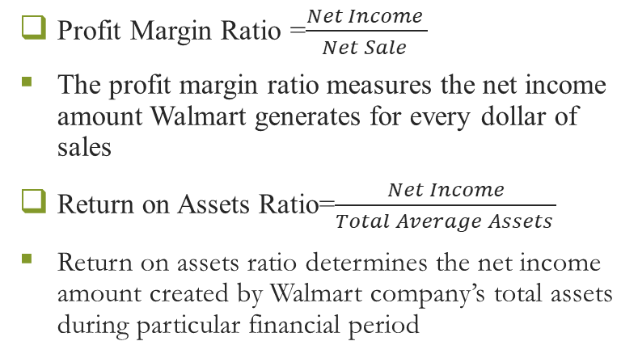
Profitability Ratio
Walmart Company
Profit ratio | 2014 | 2015
Profit Margin | 0.03 | 0.03
Return on Assets | 0.07 | 0.07

Slide 4
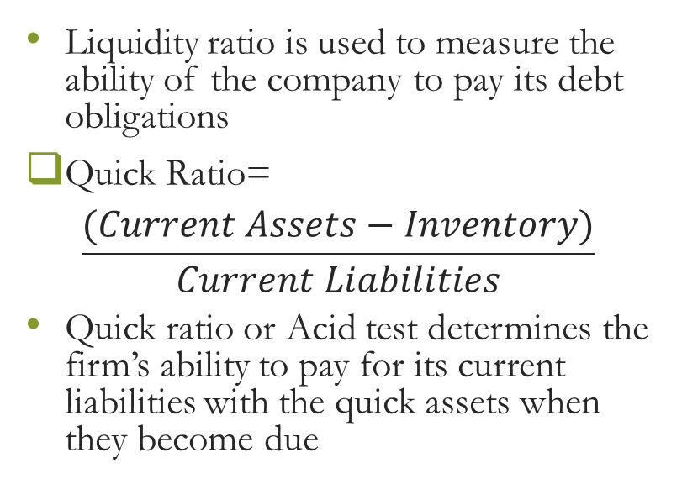
Liquidity Ratio
Liquidity Ratio | 2014 | 2015
Quick ratio | 0.870 | 0.890
Current ratio | 0.210 | 0.230

Slide 5
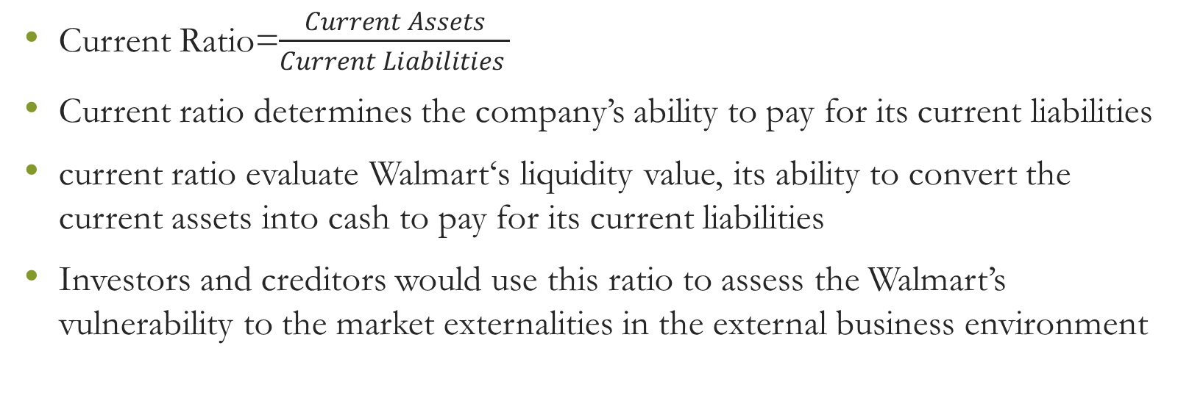

Slide 6
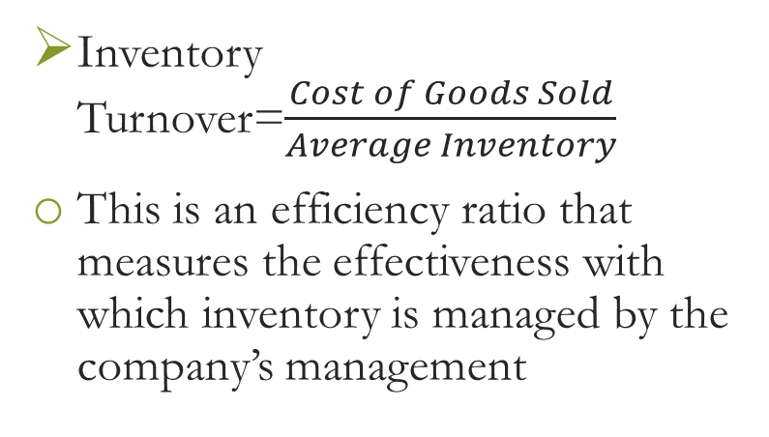
Activity Ratio
Walmart's 2014-2015 activity ratio
Activity Ratio | 2014 | 2015
Inventory Turnover | 9.30 | 8.22
Accounts Receivable Turnover | 70.12 | 72.44
Total Asset Turnover | 2.14 | 2.46

Slide 7
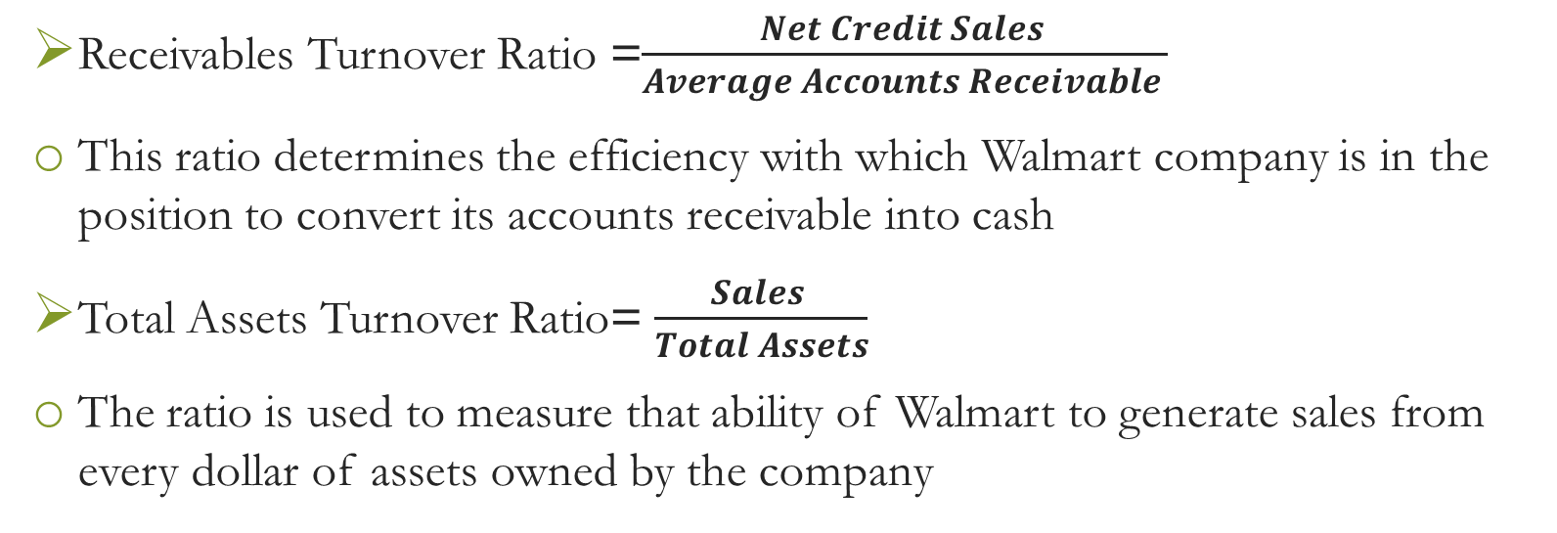

Slide 8
Conclusion
Walmart Company proved to be well performing business enterprise
Through the analysis on the profit margin, return on assets, liquidity ratios, and activity ratios shows that Walmart is operating fairly efficient and effective in creating more revenues from their current and capital assets.

Slide 9
References
Tracy, A. (2012). Ratio analysis fundamentals
R, Peavler Market (2018) The Balance Small Business: Value Ratios Can Tell You Plenty about a Company Revisited from
https://www.thebalancesmb.com/what-are-market-value-ratios-and-how-are-they-used-393224
Walmart Stores Inc Annual Report, (2015). Walmart Stores Inc. - AnnualReports.com. Annualreports.com. Retrieved 3 February 2017, fromhttp://s2.q4cdn.com/056532643/files/doc_financials/2015/annual/2015-annual-report.pdf

